Slide 1
2018 Employment, Unemployment, and Education Findings from 2018 Annual Averages, Current Population Survey
Women Veterans
Dr. Nancy A. Glowacki – glowacki.nancy.a@dol.gov – 202-693-4712

Slide 2
Employment Rates, Unemployment Rates, and Educational Attainment

Slide 3
Women veterans are more likely than male veterans to be employed
The employment-population ratio is the percent of the civilian noninstitutional population who are employed
U.S. Department of Labor, Bureau of Labor Statistics, 2018 Current Population Survey, Annual Averages, Unpublished Tables (Calculations done within VETS)

Slide 4
Women veterans are less likely than male veterans to usually work full-time, but more likely than women nonveterans to usually work full-time (compared to part-time work)
U.S. Department of Labor, Bureau of Labor Statistics, 2018 Current Population Survey, Annual Averages, Unpublished Tables (Calculations done within VETS)

Slide 5
In 2018, the unemployment rate of all women veterans was lower than that of male veterans or nonveterans of either gender, however these differences are not statistically significant*
The unemployment rate is the percent of the labor force who are not currently working, but are available for work and actively seeking work
* margin of error at 90% confidence interval: male veterans +/- .3, male nonveterans +/- .1, women veterans +/- .7, women nonveterans +/- .1
U.S. Department of Labor, Bureau of Labor Statistics, 2018 Current Population Survey, Annual Averages, Unpublished Tables (Calculations done within VETS)

Slide 6
The average duration of unemployment is longer for women veterans than for male veterans or nonveterans of either gender
U.S. Department of Labor, Bureau of Labor Statistics, 2018 Current Population Survey, Annual Averages, Unpublished Tables (Calculations done within VETS)

Slide 7
Educational Attainment
Educational Attainment

Slide 8
Women veterans are more likely than male veterans to have some college or to be college graduates
Women veterans are more likely than nonveterans to have some college or to be college graduates
U.S. Department of Labor, Bureau of Labor Statistics, 2018 Current Population Survey, Annual Averages, Unpublished Tables (Calculations done within VETS)

Slide 9
Women veterans are more likely than male veterans to be enrolled in school
Among women 25-54 years old, veterans are twice as likely as nonveterans to be enrolled in school
U.S. Department of Labor, Bureau of Labor Statistics, 2018 Current Population Survey, Annual Averages, Unpublished Tables (Calculations done within VETS)

Slide 10
Among 18-54 year olds enrolled in school, veterans are more likely than nonveterans to be in the labor force
U.S. Department of Labor, Bureau of Labor Statistics, 2018 Current Population Survey, Annual Averages, Unpublished Tables (Calculations done within VETS)

Slide 11
Among 18-54 year olds enrolled in school and seeking employment, veterans are more likely than nonveterans to be seeking full-time work (compared to part-time work)
U.S. Department of Labor, Bureau of Labor Statistics, 2018 Current Population Survey, Annual Averages, Unpublished Tables (Calculations done within VETS)

Slide 12
Unemployment Rates
Unemployment Rates

Slide 13
Unemployment Rates, continued
U.S. Department of Labor, Bureau of Labor Statistics, 2018 Current Population Survey, Annual Averages, Unpublished Tables (Calculations done within VETS)

Slide 14
The highest unemployment rates are among 18-54 year olds enrolled in school
U.S. Department of Labor, Bureau of Labor Statistics, 2018 Current Population Survey, Annual Averages, Unpublished Tables (Calculations done within VETS)

Slide 15
In 2018 there were 22,000 unemployed 18-54 year old veterans enrolled in school
Among these, 23% (5,000) were women veterans
U.S. Department of Labor, Bureau of Labor Statistics, 2018 Current Population Survey, Annual Averages, Unpublished Tables (Calculations done within VETS)

Slide 16
DOL VETS Women Veteran webpage
Women Veterans
www.dol.gov/vets/womenveterans

Slide 17
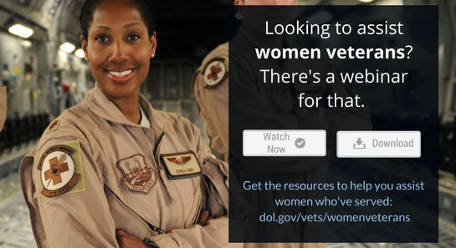
Closing Slide
Women Veterans
Dr. Nancy A. Glowacki – glowacki.nancy.a@dol.gov – 202-693-4712

